Slide 1
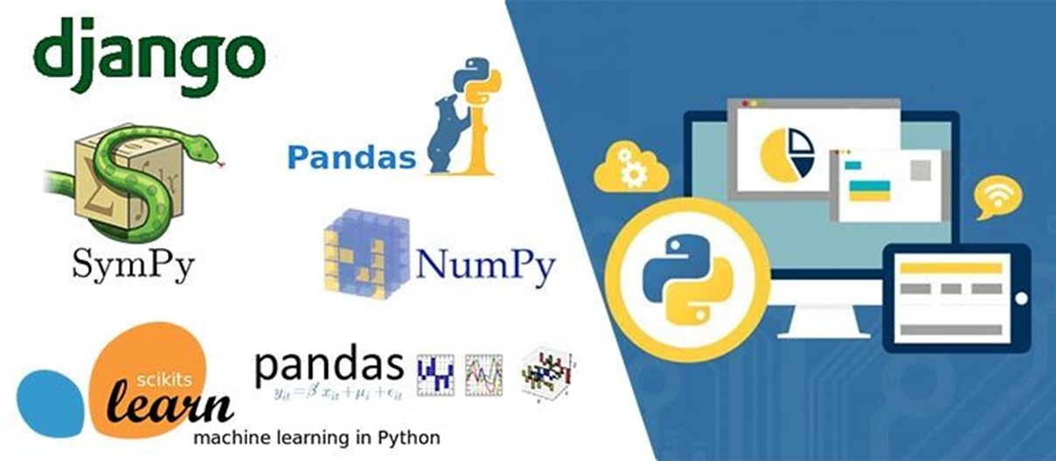
Python: Data analytics Libraries

Slide 2
Agenda
Basics of Numpy
Basics of Pandas
Data visualisation using pandas
Basics of Scipy
Matplotlib
Seaborn
Plotty
Cufflinks

Slide 3
Data Analytics Tools : Numpy

Slide 4
Introduction
NumPy is the core library for scientific computing in Python.
It contains among other things:
a powerful N-dimensional array object and tools for working with these arrays
sophisticated (broadcasting) functions
tools for integrating C/C++ and Fortran code
useful linear algebra, Fourier transform, and random number capabilities
Besides its obvious scientific uses, NumPy can also be used as an efficient multi-dimensional container of generic data.
Notes:
Like Pandas Numpy is also a core library for scientific computing in Python.
It contains among other things:
a powerful N-dimensional array object and tools for working with these arrays
sophisticated (broadcasting) functions
tools for integrating C/C++ and Fortran code
useful linear algebra, Fourier transform, and random number capabilities
Besides its obvious scientific uses, NumPy can also be used as an efficient multi-dimensional container of generic data.

Slide 5
What is the need of Numpy?
List is powerful, collection of values
Hold different types and you can change, add or remove elements from the list
But for data scientist you need to apply operations on entire array
Mathematical operations on entire collection of data set/list/arrays
Speed Solution is numpy (numerical python): you can perform operations on entire arrays.
Notes:
NumPy arrays are more compact and faster than Python lists.
An array uses less memory and is easier to work with.
NumPy stores data in a substantially smaller amount of memory and has a way for specifying data types.
This enables for even more code optimization.

Slide 6
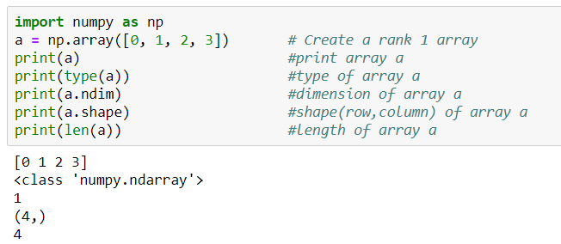
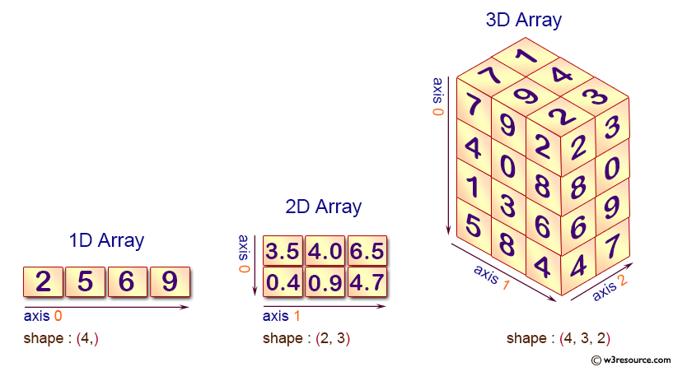
Numpy Array
Scalar
Vector
Matrix
Tensor
Notes:
A numpy array is a grid of identical-type values indexed by a tuple of nonnegative integers.
The array's rank is the number of dimensions;
the shape is a tuple of numbers indicating the array's size along each dimension.

Slide 7
Working with array’s in Numpy
Create 2-D array using numpy from list
import numpy as np
mylist=[[1,2,3],[4,5,6],[7,8,9]]
np.array(mylist)
Create 1-D and 2-D array using random values
np.random.rand(5) #uniform distribution of random values
np.random.rand(4,4) # create 2-D array of random values
np.random.randn(4) #std. normal distribution, centered around 0
Notes:
Sample code for creating two Dimensional arrays from a list and also using random values are shown here

Slide 8
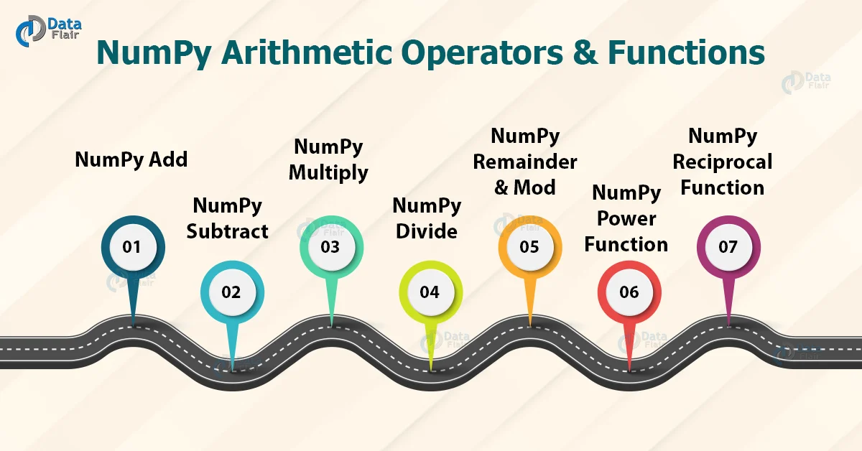
Numpy Numerical Operations
Add- np.add(a, b)
Subtract- np.subtract(a, b)
Multiply- np.multiply(a, b)
Divide- np.divide(a, b)
Remainder - np.remainder(a,b)
Modulus - np.mod(a,b)
Power- np.power(a,b)
Reciprocal- np.reciprocal(a)
https://data-flair.training/blogs/numpy-arithmetic-operations/
Notes:
The conventional arithmetic procedures in Python are extensive. These operations aid in the execution of basic addition, subtraction, multiplication, and division operations. In NumPy, there are functions for performing arithmetic operations. Let's take a look at NumPy's arithmetic operations and functions.

Slide 9
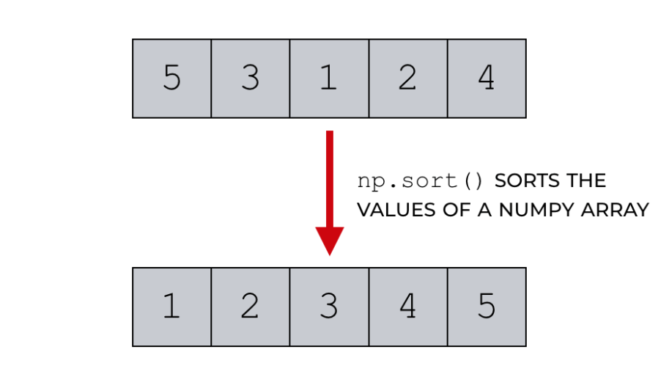
Numpy methods & attributes
np.array()
np.random.randint(0,10,1)
np.unique()
np.dot()
np.power(a,2)
np.sqrt(a)
np.ones()
np.zeros()
np.max()
np.arange(10)
a.size
a.ndim
a.dtype
a.shape
Notes:
Array methods and attributes are used perform various operations.
Attributes reflect information that is intrinsic to the array itself.
Generally, accessing an array through its attributes allows you to get and sometimes set intrinsic properties of the array without creating a new array.
Commonly used Numpy methods and attributes are shown here.

Slide 10
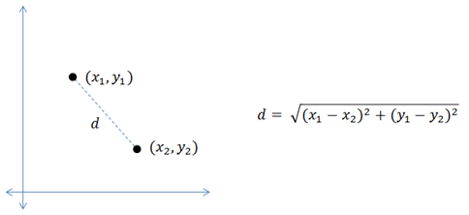
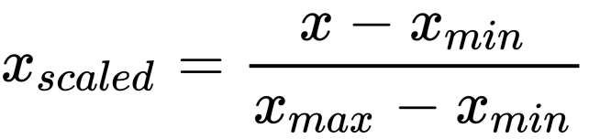
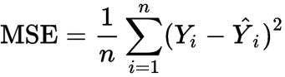
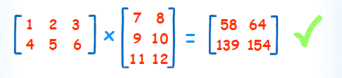
Numpy Operations
1. Euclidean Distance
2. Normalization using Min Max Scalar
3. Matrix Multiplication (Dot Product)
4. Mean Squared Error
Notes:
Numpy operations such as Calculation of Euclidian Distance, Normalization using min max scaler, Matrix multiplication , computation of Mean squared error are shown here.

Slide 11
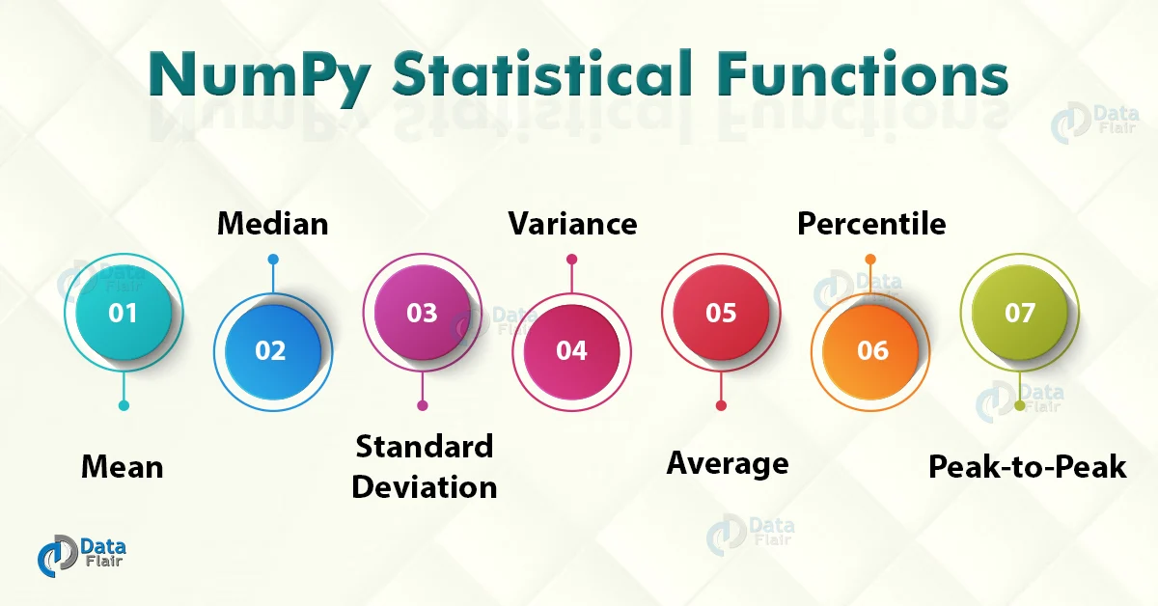
Numpy: Statistical Functions
1. np.amin()- This function determines the minimum value of the element along a specified axis. 2. np.amax()- This function determines the maximum value of the element along a specified axis. 3. np.mean()- It determines the mean value of the data set. 4. np.median()- It determines the median value of the data set. 5. np.std()- It determines the standard deviation 6. np.var – It determines the variance. 7. np.ptp()- It returns a range of values along an axis. 8. np.average()- It determines the weighted average 9. np.percentile()- It determines the nth percentile of data along the specified axis.
https://data-flair.training/blogs/numpy-statistical-functions/
Notes:
The field of statistics is concerned with gathering and interpreting data. It covers procedures for collecting samples, describing data, and concluding the data. NumPy is the core package for scientific calculations, hence NumPy statistical Functions go hand-in-hand with it.
NumPy has a number of statistical functions for performing statistical data analysis. When looking for a maximum or minimum of elements, these statistical functions come in handy. It can also be used to figure out basic statistical concepts like standard deviation and variance.
Various Statistical Functions in NumPy are:
np.amin()- This function determines the minimum value of the element along a specified axis. 2. np.amax()- This function determines the maximum value of the element along a specified axis. 3. np.mean()- It determines the mean value of the data set. 4. np.median()- It determines the median value of the data set. 5. np.std()- It determines the standard deviation 6. np.var – It determines the variance. 7. np.ptp()- It returns a range of values along an axis. 8. np.average()- It determines the weighted average 9. np.percentile()- It determines the nth percentile of data along the specified axis.

Slide 12
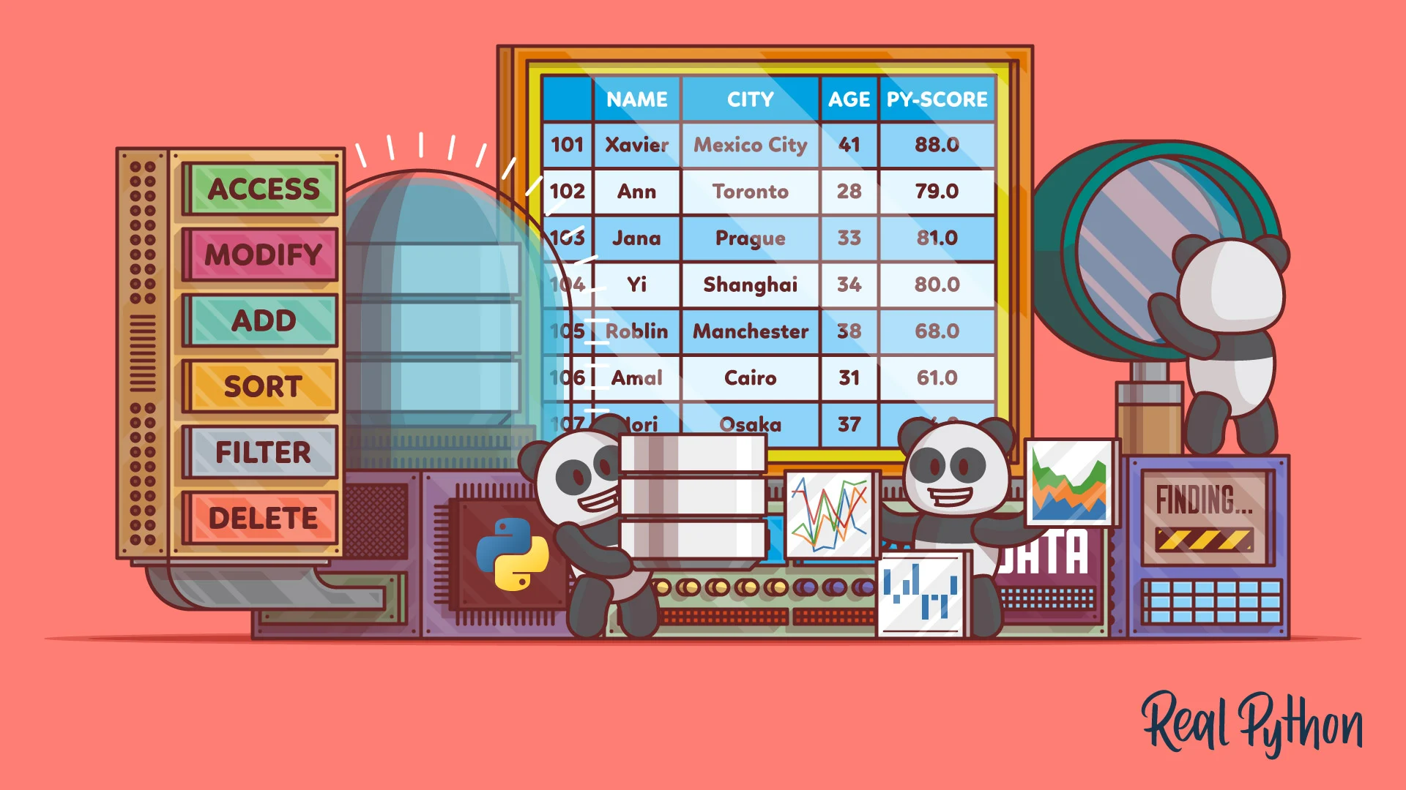
Introduction to Pandas
Pandas is an open-source, BSD-licensed Python library providing high-performance, easy-to-use data structures and data analysis tools for the Python programming language.
Pandas is built on top of NumPy library.
Pandas is well suited for many different of data
Image Source: https://realpython.com/pandas-dataframe/
Notes:
pandas is an open-source, BSD-licensed Python library providing high-performance, easy-to-use data structures and data analysis tools for the Python programming language.
pandas is built on top of NumPy library.
pandas is well suited for many different of data:
Tabular data with heterogeneously-typed columns, as in an SQL table or Excel spreadsheet
Ordered and unordered (not necessarily fixed-frequency) time series data.
Arbitrary matrix data (homogeneously typed or heterogeneous) with row and column labels
Any other form of observational / statistical data sets. The data actually need not be labeled at all to be placed into a pandas data structure

Slide 13
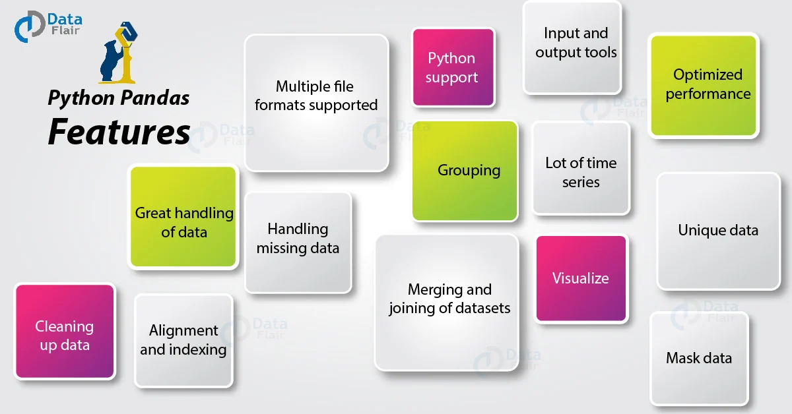
Features of Pandas
Image Source: https://data-flair.training/blogs/python-pandas-features/
Notes:
This slide deals with the features of Pandas:
The key characteristics of Pandas are:
We can import, prepare, modify, model, and analyze data with Pandas, regardless of its origin.
With default and customizable indexing, the Data Frame object is quick and efficient.
Tools for loading data from various file formats into in-memory data objects.
Data alignment and handling of missing data in a unified manner.
Date sets can be reshaped and pivoted.
Slicing, indexing, and sub setting of big data sets depending on labels.
A data structure's columns can be removed or added.
For aggregation and transformations of data, group by function is used .
Data merging and joining with high performance.
Time Series based functionality is one the useful feature of Pandas

Slide 14
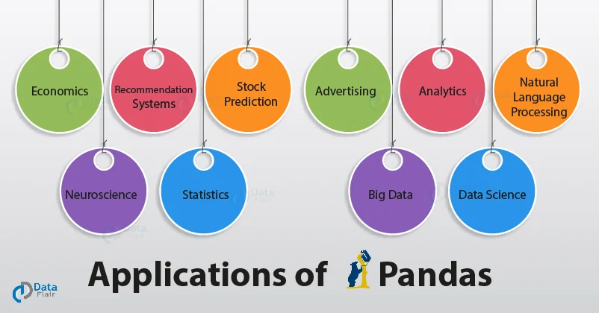
Applications of Pandas
Image Source: https://data-flair.training/blogs/applications-of-pandas/
Notes:
Next is about, different application areas of Pandas
Pandas can be used in many industrial sectors for variety of applications. Some of them are explained as follows:
In Economics: Many modern-day economists use pandas and python to work with large datasets and analyze them. Pandas has a long range of built-in tools and functions that help it to be the effective package it is.
In Neuroscience: Understanding how our brains (and hence the whole nervous system) operate has long been an unrealized dream of doctors since they feel it would aid in the discovery of answers to many of our body's riddles. Machine Learning has greatly aided this subject, thanks to the multiple uses of pandas.
Pandas in Recommendation systems on Online Platforms: Pandas can handle a lot of data, which makes it easier for it to understand the massive amounts of data required to construct a solid recommendation system. These recommendation algorithms need on functions like mapping and GroupBy to function properly.
In statistics: Statistics entails dealing with large amounts of data. As a result, a library like pandas may assist in a variety of ways because it primarily works with various types of data processing and operations. When completing statistical computations, the fundamental functions of mean, median, and mode come in handy. There are a slew of other functions in pandas that might assist you improve your statistics findings.
In Natural language Processing: With pandas and Scikit-Learn at your disposal, you can build a rudimentary NLP model that you can improve later. You may utilize a variety of functions and libraries to assist you.
Due the data handling capability of Pandas, it can be also used in the field of advertising and also for big data analytics
Ref: https://www.studytonight.com/pandas/application-of-pandas-in-data-science-industry

Slide 15
Most commonly used functions in Pandas
read_csv()
head() /head(n)
describe()
memory_usage()
astype()
loc[:]
to_datetime()
value_counts()
drop_duplicates()
groupby()
merge()
sort_values()
fillna()
Notes:
As we discussed Pandas is a library that deals with data and it consist of functions that can handle data
Most commonly used thirteen functions of pandas and its uses are explained here
read_csv() function helps read a comma-separated values (csv) file into a Pandas DataFrame.
head(n) is used to return the first n rows of a dataset. By default, head() will return the first 5 rows of the DataFrame.
describe() is a Pandas DataFrame or Series function that generates descriptive statistics for the data. It describes the dataset's central tendency and dispersion. describe() is useful for quickly acquiring an overview of a dataset.
memory_usage() returns a Pandas Series having the memory usage of each column (in bytes) in a Pandas DataFrame.
The astype() function is used to convert a Python object to a certain data type. It can be a very useful feature if your data isn't saved in the right format.
loc[:] allows us to access a collection of rows and columns in a dataset, or a slice of the dataset, as needed.
to_datetime() is a Python function that transforms a Python object to datetime format.
value counts() produces a Pandas Series with unique value counts.
drop_duplicates() provides a Pandas DataFrame that is free of duplicate entries.
groupby() is a Pandas DataFrame function that groups data by one or more columns and performs a mathematical operation on it. The function groupby() can be used to quickly summarise data.
On a common column, merge() is used to join two Pandas DataFrame objects or a DataFrame and a Series object (field).
Sort columns in a Pandas DataFrame (or a Pandas Series) by values in ascending or descending order with sort values().
Several entries in a big dataset will typically be labelled NaN by Python.
The term "not a number" refers to items that were not filled out in the original data source.
Pandas ensures that these items may be identified independently by the user while populating the data in the DataFrame.
fillna() replaces all NaN values in a DataFrame or Series with more suitable values by imputing these missing values.

Slide 16
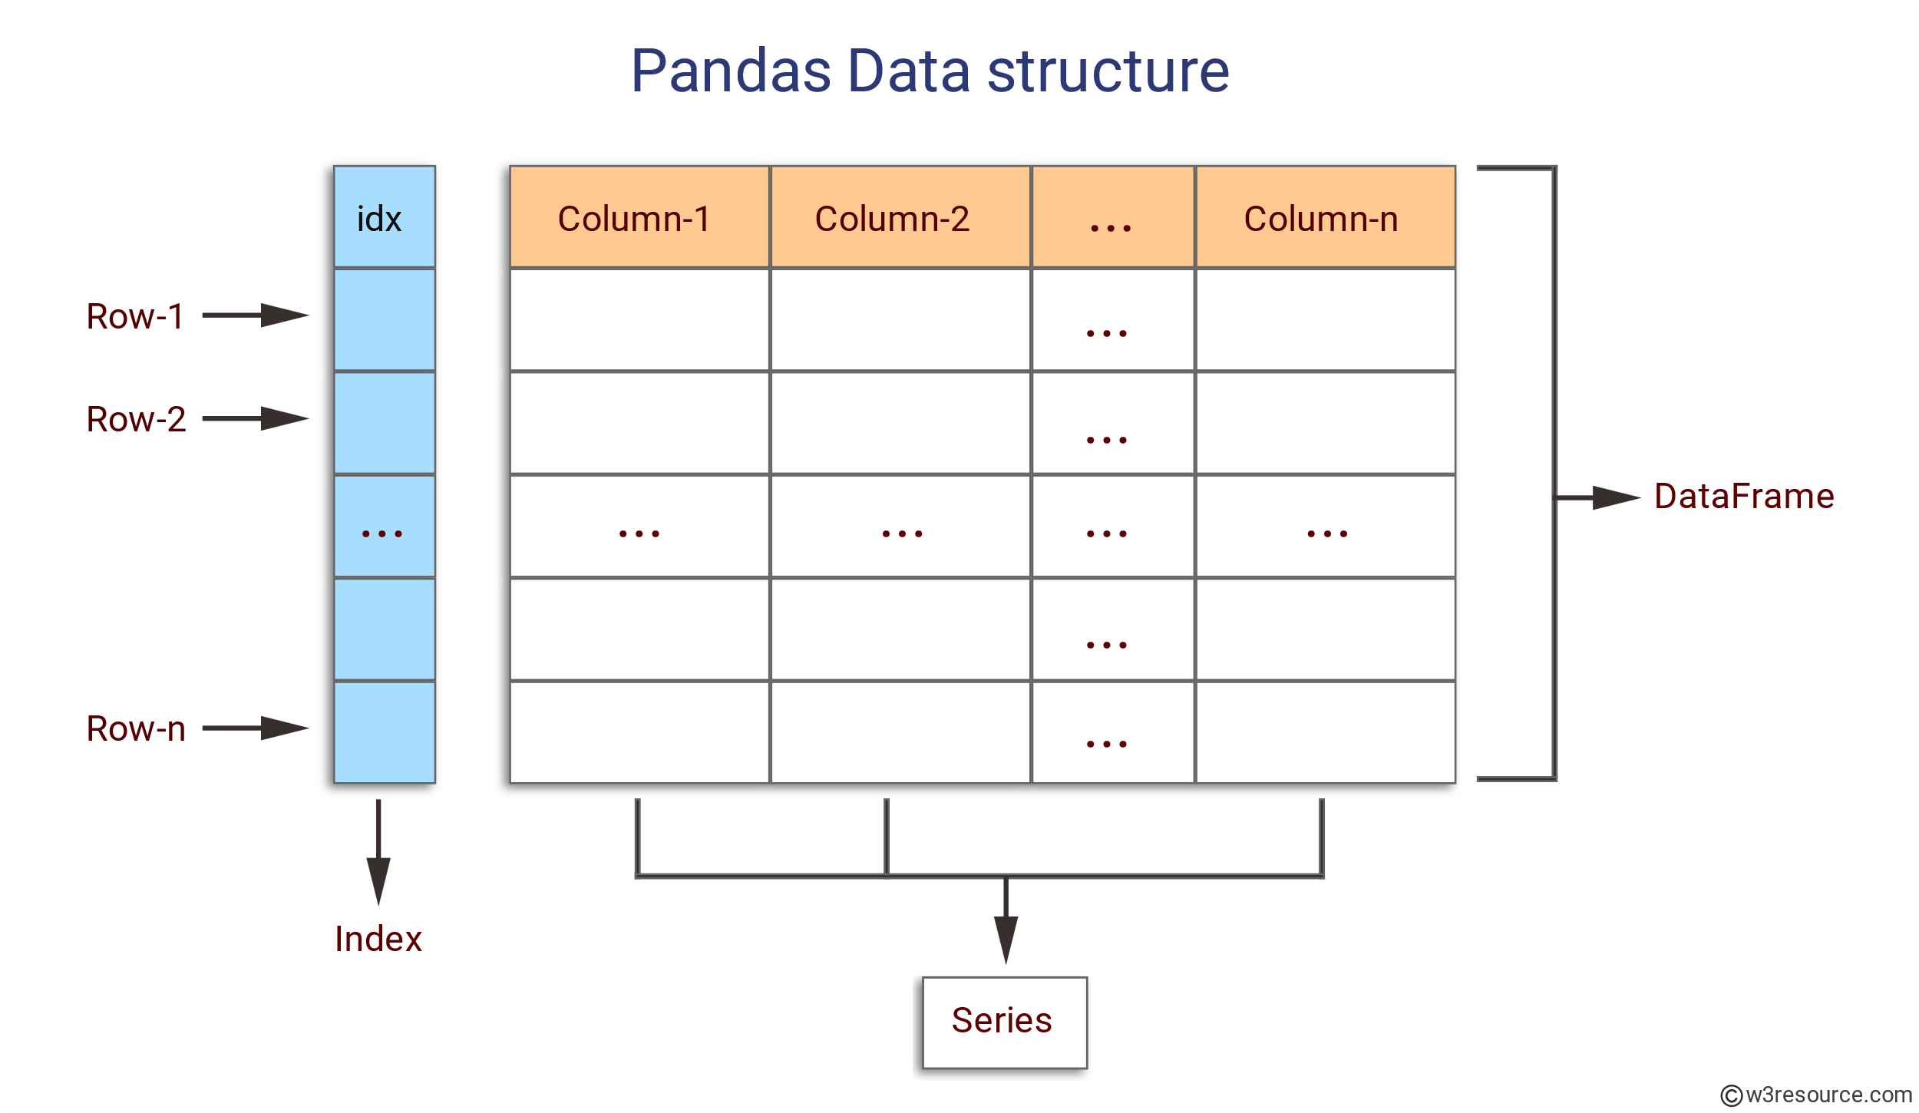
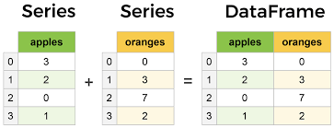
Core components of Pandas : Series and Data Frame
https://www.learndatasci.com/tutorials/python-pandas-tutorial-complete-introduction-for-beginners/
Notes:
The Series and DataFrame are the two most important parts of pandas.
A Series is a multi-dimensional table made up of a collection of Series, while a DataFrame is a multi-dimensional table made up of Series.
DataFrames are the Pandas data type for storing tabular 2D data, and Pandas is the most used data manipulation programme in Python.
The figure represents Pandas series and Data Frame.

Slide 17
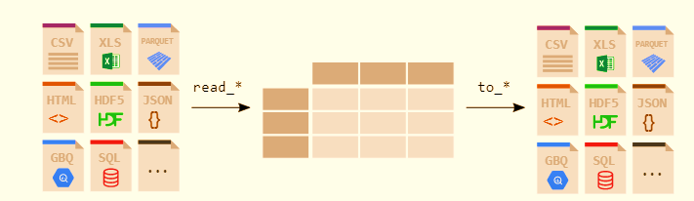
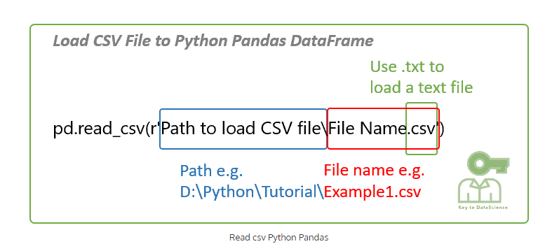
File Handling with Pandas
https://pandas.pydata.org/docs/getting_started/intro_tutorials/02_read_write.html
Notes:
Any analyst or data scientist should be able to read data from CSV files and write data to CSV files using Python.
The read_csv() method in pandas allows you to read data from a csv file into a pandas DataFrame.
Pandas comes with support for a variety of file formats and data sources (csv, excel, sql, json, parquet, and so on), all of which begin with the prefix read_*.

Slide 18
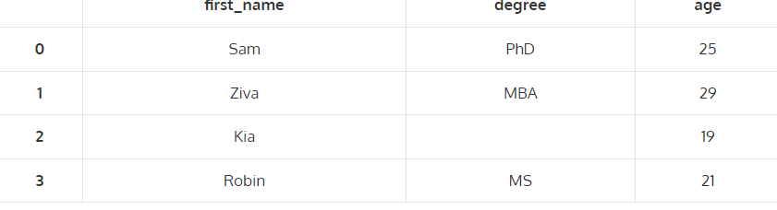
Sample Reading and writing .csv file
import pandas as pd
# Create a dataframe
raw_data = {'first_name': ['Sam','Ziva','Kia','Robin'],
'degree': ['PhD','MBA','','MS'],
'age': [25, 29, 19, 21]}
df = pd.DataFrame(raw_data)
df
#Save the dataframe
df.to_csv(r'Example1.csv')
import pandas as pd
# Read csv file
df = pd.read_csv(r'D:\Python\Tutorial\Example1.csv')
df
Output
Notes:
The sample code for reading and writing of CSV file is shown here
To read the csv file DataFrame you just created to a csv file, Enter the path and filename where the csv file is stored.
You may try this code in Jupyter notebook

Slide 19
Exploring a dataset using Pandas
Download the dataset from: https://drive.google.com/file/d/1q7qK03njlzZRQ7PyYoprn12uVnE1gjH6/view
Import pandas as pd
data_1 = pd.read_csv(r‘<datasetpath>')
data_1.head(6)
data_1.describe()
data_1.memory_usage(deep=True)
data_1['Gender'] = data_1.Gender.astype('category')
data_1.loc[0:4, ['Name', 'Age', 'State']]
data_1['DOB'] = pd.to_datetime(data_1['DOB'])
data_1['State'].value_counts()
data_1.drop_duplicates(inplace=True)
data_1.groupby(by='State').Salary.mean()
data_1.sort_values(by='Name', inplace=True)
Notes:
Download the dataset from the link provided and explore the dataset using the popular functions in pandas
The dataset set path along with the csv file name should be specified in the space provided
You may try this in jupyter notebook
https://www.analyticsvidhya.com/blog/2021/05/pandas-functions-13-most-important/

Slide 20
Convert list and dictionary into series of elements
# convert element lists into series of elements, which have index from 0—5
import pandas as pd
my_data=[10,20,30,40,50]
pd.Series(data=my_data)
import numpy as np
import pandas as pd
d={'a':10,'b':20,'c':30,'d':40}
#dictionary keys act as index and values with every key act as series values
pd.Series(d)
Notes:
The sample code for converting list into list and dictionary series of elements shown here.

Slide 21
Data Manipulation: Drop missing elements
import pandas as pd
import numpy as np
d={'A':[1,2,np.NaN], 'B':[1,np.NaN,np.NaN],'C':[1,2,3]}
# np.NaN is the missing element in DataFrame
df=pd.DataFrame(d)
df.dropna() #pandas would drop any row with missing value
df.dropna(axis=1) #drop column with NULL value
Notes:
The sample code for dropping missing values by dropping corresponding row or column is shown here
Here np.NaN is the missing element in DataFrame

Slide 22
Data Manipulation: Filling suitable value
df.fillna(value='FILL VALUE') #NaN is replaced by value=FILL VALUE
df['A'].fillna(value=df['A'].mean())
#Select column "A" and fill the missing value with mean value of the column A
df['A’].fillna(value=df['A’].std())
#Select column "A" and fill the missing value with standard deviation value of the column A
Notes:
The code shown here is to fill the missing value with a particular value or
by Selecting column "A" and fill the missing value with mean value of the column A or
By Selecting column "A" and fill the missing value with standard deviation value of the column A

Slide 23
Replacing a value
import pandas as pd
df = pd.DataFrame({'one':[10,20,30,40,50,2000], 'two':[1000,0,30,40,50,60]})
print (df.replace({1000:10,2000:60}))
Notes:
Many times, we have to replace a generic value with some specific value.
We can achieve this by applying the replace method.
Replacing NA with a scalar value is equivalent behavior of the fillna() function.
In this case 1000 is replaced with 10 and 2000 is replaced with 60 using replace method.

Slide 24
Groupby() function
data = {'Company’: [ ‘CompA’, ‘CompA’, ‘CompB’, ‘CompB’, ‘CompC’, ‘CompC’],
'Person’: [‘Rajesh’, ‘Pradeep’, ‘Amit’, ‘Rakesh’, ‘Suresh’, ‘Raj’],
'Sales’: [200, 120, 340, 124, 243, 350]}
df=pd.DataFrame(data)
df
comp=df.groupby("Company").mean()
comp
comp1=df.groupby("Company") #grouping done using label name “Company”
comp1.std() #apply standard deviation on grouped data
Notes:
The groupby() function divides data into groups depending on a set of criteria.
Any of the axes can be used to separate pandas objects. Grouping is defined as a mapping of labels to group names in its most basic form.
In the code provided here, grouping based on company name and applying statistics like Mean or standard deviation to the grouped data is performed.

Slide 25
Finding maximum value in each label
data = {'Company’: [ ‘CompA’, ‘CompA’, ‘CompB’, ‘CompB’, ‘CompC’, ‘CompC’],
'Person’: [‘Rajesh’, ‘Pradeep’, ‘Amit’, ‘Rakesh’, ‘Suresh’, ‘Raj’],
'Sales’: [200, 120, 340, 124, 243, 350]}
df=pd.DataFrame(data)
df
df.groupby("Company").max()
Notes:
Here the dataset is grouped based on ‘company’ label and pick maximum value in each label

Slide 26
Finding unique value & number of occurrence from Dataframe
df = pd.DataFrame({'col1':[1,2,3,4],'col2':[444,555,666,444],'col3':['abc','def','ghi','xyz’]})
# col1, col2 & col3 are column labels, each column have their own values
df['col2'].unique() #fetches the unique values available in column
df['col2'].value_counts() # count number of occurrence of every value
Notes:
The code provided here:
fetches the unique values available in column 2
count number of occurrence of every value in column 2

Slide 27
Introduction to Matplotlib
“We humans are typical visual creatures: we understand things better when we see things visualized”
To make necessary statistical inferences, it becomes necessary to visualize your data and Matplotlib is one such solution for the Python users.
matplotlib.pyplot is a plotting library used for 2D graphics in python programming language. It can be used in python scripts,
shell, web application servers and other graphical user interface toolkits.
It is a very powerful plotting library useful for those working with Python and NumPy.
Notes:
Matplotlib is a Python 2D plotting library which produces publication quality figures in a variety of hardcopy formats and interactive environments across platforms.
Matplotlib can be used in Python scripts, the Python and IPython shells, the Jupyter notebook, web application servers, and four graphical user interface toolkits.
can generate plots, histograms, power spectra, bar charts, errorcharts, scatterplots, etc., with just a few lines of code.

Slide 28
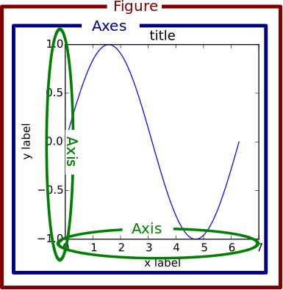
Matplotlib Figure Components
A Matplotlib figure can be categorized into several parts as below:
Figure
Axes
Axis
Artist
Notes:
A Matplotlib figure can be categorized into several parts as below:
Figure
Axes
Axis
Artist
Each component is marked in the diagram with the corresponding correct of text

Slide 29
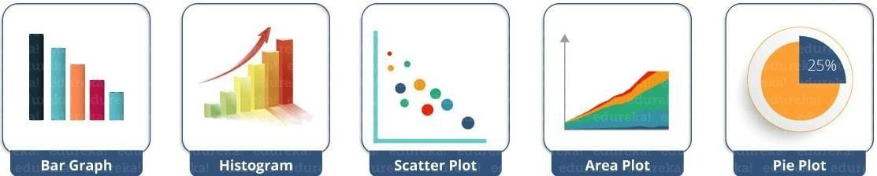
Common matplotlib.pyplot Functions
plot() – plot lines or markers to axes
scatter() – makes scatter plot for X vs Y
bar() – makes a bar graph
barh() – makes a horizontal bar graph
hist() – plot a histogram
hist2d() – make a 2D histogram plot
boxplot() – make a box and whisker plot
pie() – plot a pie graph
Notes:
Pyplot is a state-based interface to a MATLAB-like Matplotlib module.
Line Plot, Contour, Histogram, Scatter, 3D Plot, and others are some of the plots available in Pyplot.
The functions used to plot various types of charts are shown here

Slide 30
Common Axis Functions
axes() – add axes to figure
text() – add text to axes
title() – set title of current axes
xlabel() & ylabel() – set x-axis or y-axis label for current axes
xlim() & ylim() – set x or y limits of current axes
xscale() & yscale() – set the scaling for x-axis or y-axis
xticks() & yticks() – set x or y limits of current tick locations and labels
Notes:
This function is used to set some axis properties to the graph are shown here
xmin, xmax, ymin, ymax: These parameters can be used to set the axis limits on the graph

Slide 31
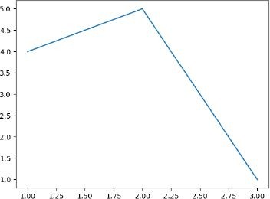
Example Plot
from matplotlib import pyplot as plt #Plotting to our canvas plt.plot([1,2,3],[4,5,1])
#Showing what we plotted
plt.show()
Notes:
The program depicted here is to draw a simple plot using given values

Slide 32
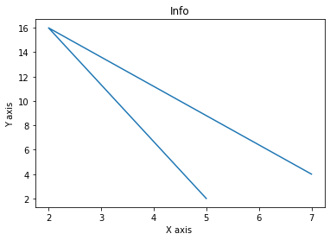
Example Plot: Xlabel, Ylabel and Title
from matplotlib import pyplot as plt x = [5,2,7]
y = [2,16,4]
plt.plot(x,y)
plt.title('Info')
plt.ylabel('Y axis') plt.xlabel('X axis')
plt.show()
Notes:
The program depicted here is to plot a graph with Title of the plot , X axis label and Y axis Label

Slide 33
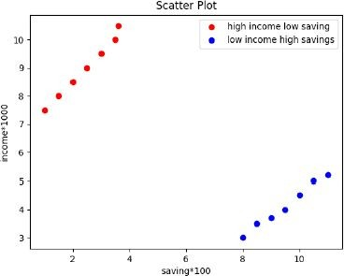
Example Scatter Plot
import matplotlib.pyplot as plt x = [1,1.5,2,2.5,3,3.5,3.6]
y = [7.5,8,8.5,9,9.5,10,10.5]
x1=[8,8.5,9,9.5,10,10.5,11]
y1=[3,3.5,3.7,4,4.5,5,5.2]
plt.scatter(x,y, label='high income low saving',color='r') plt.scatter(x1,y1,label='low income high savings',color='b')
plt.title('Scatter Plot’)
plt.xlabel('saving*100')
plt.ylabel('income*1000’)
plt.legend()
plt.show()
Notes:
The program depicted here is to plot a scatter plot with given set of values and specified colors such as red and blue

Slide 34
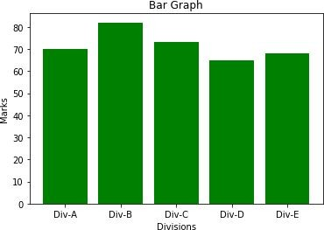
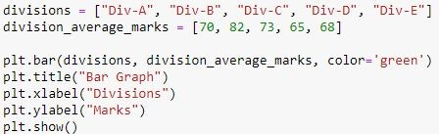
Example Bar Graph
Notes:
The program depicted here is to draw a green color filled bar graph with given set of values
A bar plot or bar graph is a graph that uses rectangular bars with lengths and heights proportionate to the values they reflect to depict a category of knowledge. Bar plots are frequently arranged vertically or horizontally.

Slide 35
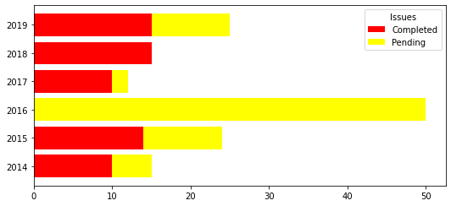
Example Bar Graph (Stacked Horizontally)
from matplotlib import pyplot as plt
plt.rcParams["figure.figsize"] = [7.50, 3.50]
plt.rcParams["figure.autolayout"] = True
year = [2014, 2015, 2016, 2017, 2018, 2019]
issues_addressed = [10, 14, 0, 10, 15, 15]
issues_pending = [5, 10, 50, 2, 0, 10]
b1 = plt.barh(year, issues_addressed, color="red")
b2 = plt.barh(year, issues_pending, left=issues_addressed, color="yellow")
plt.legend([b1, b2], ["Completed", "Pending"], title="Issues", loc="upper right")
plt.show()
https://www.tutorialspoint.com/horizontal-stacked-bar-chart-in-matplotlib
Notes:
To plot stacked bar chart in Matplotlib, we can use barh() methods

Slide 36
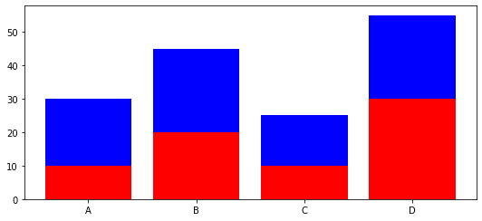
Example Bar Graph (Stacked Vertically)
# importing package
import matplotlib.pyplot as plt
# create data
x = ['A', 'B', 'C', 'D']
y1 = [10, 20, 10, 30]
y2 = [20, 25, 15, 25]
# plot bars in stack manner
plt.bar(x, y1, color='r')
plt.bar(x, y2, bottom=y1, color='b')
plt.show()
https://www.geeksforgeeks.org/create-a-stacked-bar-plot-in-matplotlib/
Notes:
Different groups are represented by stacked bar plots on top of one another. The height of the resulting blend of the groups' results determines the bar's apex. Rather than going from zero to value, it moves from the bottom to the top.

Slide 37
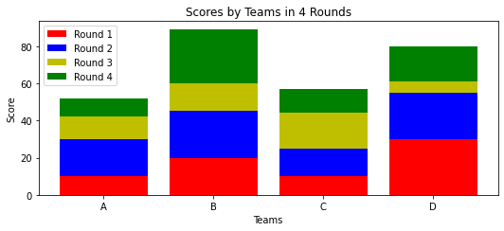
Stacked bar chart with more than 2 data
# importing package
import matplotlib.pyplot as plt
import numpy as np
# create data
x = ['A', 'B', 'C', 'D']
y1 = np.array([10, 20, 10, 30])
y2 = np.array([20, 25, 15, 25])
y3 = np.array([12, 15, 19, 6])
y4 = np.array([10, 29, 13, 19])
# plot bars in stack manner
plt.bar(x, y1, color='r')
plt.bar(x, y2, bottom=y1, color='b')
plt.bar(x, y3, bottom=y1+y2, color='y')
plt.bar(x, y4, bottom=y1+y2+y3, color='g')
plt.xlabel("Teams")
plt.ylabel("Score")
plt.legend(["Round 1", "Round 2", "Round 3", "Round 4"])
plt.title("Scores by Teams in 4 Rounds")
plt.show()
https://www.geeksforgeeks.org/create-a-stacked-bar-plot-in-matplotlib/
Notes:
The sample program for plotting bar charts with more than two data is shown here

Slide 38
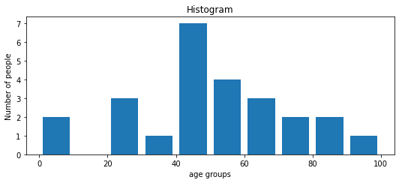
Histogram
import matplotlib.pyplot as plt
population_age = [22,55,62,45,21,22,34,42,42,4,2,102,95,85,55,110,120,70,65,55,111,115, 80,75,65,54,44,43,42,48]
bins = [0,10,20,30,40,50,60,70,80,90,100]
plt.hist(population_age, bins, histtype='bar', rwidth=0.8)
plt.xlabel('age groups')
plt.ylabel('Number of people')
plt.title('Histogram')
plt.show()
Notes:
A sample program for plotting histogram is shown here
A histogram is a visual representation of data that is organised into groups. It is a precise way for displaying numerical data distribution graphically. It's a sort of bar plot in which the X-axis shows bin ranges and the Y-axis represents frequency. To make a histogram, first establish a bin for the ranges, then divide the entire range of values into a series of intervals and count the values that fall into each interval. Bins are defined as non-overlapping, successive intervals of variables. To compute and create a histogram of x, use the matplotlib.pyplot.hist() function.

Slide 39
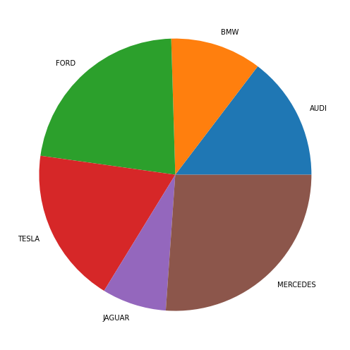
Pie-Chart
# Import libraries
from matplotlib import pyplot as plt
import numpy as np
# Creating dataset
cars = ['AUDI', 'BMW', 'FORD’, 'TESLA', 'JAGUAR', 'MERCEDES']
data = [23, 17, 35, 29, 12, 41]
# Creating plot
fig = plt.figure(figsize =(10, 7))
plt.pie(data, labels = cars)
# show plot
plt.show()
https://www.geeksforgees.orgk/plot-a-pie-chart-in-python-using-matplotlib/
Notes:
An example Pie chart is shown here.
A Pie Chart is a circular statistical layout that can only show one data series. The overall percentage of the given data is represented by the chart's area. The percentage of parts of the data is represented by the area of the pie slices. Pie wedges are the slices of the pie. The length of the wedge's arc determines the area of the wedge. The area of a wedge represents the fraction of the data that belongs to that segment. Because they provide a brief summary, pie charts are often used in business presentations such as sales, operations, survey findings, and resources. The pyplot module of the Matplotlib API offers a pie() method that creates a pie chart representing the data in an array.

Slide 40
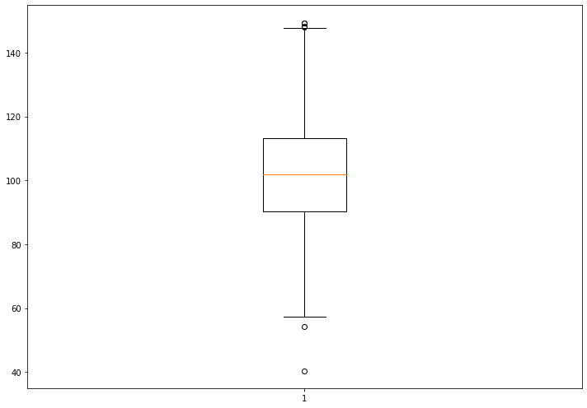
Box Plot
# Import libraries
import matplotlib.pyplot as plt
import numpy as np
# Creating dataset
np.random.seed(10)
data = np.random.normal(100, 20, 200)
fig = plt.figure(figsize =(10, 7))
# Creating plot
plt.boxplot(data)
# show plot
plt.show()
https://www.geeksforgeeks.org/box-plot-in-python-using-matplotlib/
Notes:
A Box Plot, also known as a Whisker Plot, is used to show a summary of a group of data values with features such as minimum, first quartile, median, third quartile, and maximum. A box is drawn from the first quartile to the third quartile in the box plot, and a vertical line runs through the box at the median. The data to be plotted is represented by the x-axis, while the frequency distribution is shown by the y-axis. The matplotlib.pyplot module of the matplotlib library has a boxplot() method that can be used to make box plots.

Slide 41
3D Plotting
To use this functionality, we first import the module mplot3d as follows:
from mpl_toolkits import mplot3d
Once the module is imported, a three-dimensional axes is created by passing the keyword
projection='3d' to the axes() method of Pyplot module. Once the object instance is created, we pass our arguments to 3D method.
Notes:
Matplotlib was created with simply two-dimensional charting in mind. However, at the time of 1.0's release, 3d utilities were being created on top of 2d, and therefore we now have 3d data implementation! Importing the mplot3d toolbox enables the 3d plots. We will use matplotlib to create 3d graphs in this article. The simplest three-dimensional graph is a graph with lines and points. The functions ax.plot3d and ax.scatter plot line and point graphs, respectively.

Slide 42
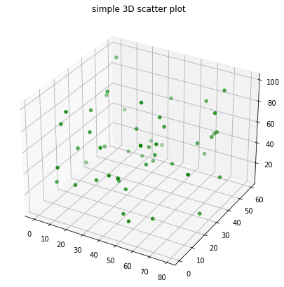
3D Plotting
# Import libraries
from mpl_toolkits import mplot3d
import numpy as np
import matplotlib.pyplot as plt
# Creating dataset
z = np.random.randint(100, size =(50))
x = np.random.randint(80, size =(50))
y = np.random.randint(60, size =(50))
# Creating figure
fig = plt.figure(figsize = (10, 7))
ax = plt.axes(projection ="3d")
# Creating plot
ax.scatter3D(x, y, z, color = "green")
plt.title("simple 3D scatter plot")
Notes:
The sample code for creating a 3D plot is shown here

Slide 43
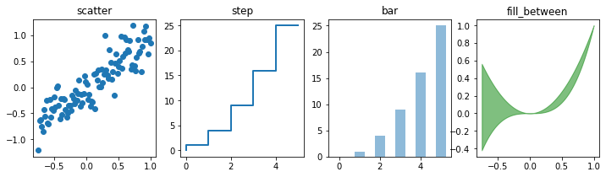
Plot different variety of graphs as subplots
import numpy as np
import matplotlib.pyplot as plt
%matplotlib inline
n = np.array([0,1,2,3,4,5])
xx = np.linspace(-0.75, 1., 100)
fig, axes = plt.subplots(1, 4, figsize=(12,3))
axes[0].scatter(xx, xx + 0.25*np.random.randn(len(xx)))
axes[0].set_title("scatter")
axes[1].step(n, n**2, lw=2)
axes[1].set_title("step")
axes[2].bar(n, n**2, align="center", width=0.5, alpha=0.5)
axes[2].set_title("bar")
axes[3].fill_between(xx, xx**2, xx**3, color="green", alpha=0.5);
axes[3].set_title("fill_between");
Notes:
Subplots are axes that can be found together in a single Matplotlib figure. The matplotlib library's subplots() function aids in the creation of numerous subplot layouts. It gives you complete control over all of the plots you've made.
The code explained here is to plots different variety of graphs as subplots.

Slide 44
Introduction to Scipy

Slide 45
What is SciPy
The SciPy is an open-source scientific library of Python that is distributed under a BSD license.
It is used to solve the complex scientific and mathematical problems.
It is built on top of the Numpy extension, which means if we import the SciPy, there is no need to import Numpy.
The Scipy is pronounced as Sigh pi, and it depends on the Numpy, including the appropriate and fast N-dimension array manipulation.
The SciPy library supports integration, gradient optimization, special functions, ordinary differential equation solvers, parallel programming tools, and many more.
The scipy is a data-processing and system-prototyping environment as similar to MATLAB. It is easy to use and provides great flexibility to scientists and engineers.

Slide 46
History of Scipy
Python was expanded in the 1990s to include an array type for numerical computing called numeric.
This numeric package was replaced by Numpy (blend of Numeric and NumArray) in 2006.
There was a growing number of extension module and developers were interested to create a complete environment for scientific and technical computing. Travis Oliphant, Eric Jones, and Pearu Peterson merged code they had written and called the new package SciPy.
The newly created package provided a standard collection of common numerical operation on the top of Numpy.

Slide 47
Why use SciPy?
SciPy contain significant mathematical algorithms that provide easiness to develop sophisticated and dedicated applications.
Being an open-source library, it has a large community across the world to the development of its additional module, and it is much beneficial for scientific application and data scientists.

Slide 48
Numpy vs. SciPy
Numpy and SciPy both are used for mathematical and numerical analysis. Numpy is suitable for basic operations such as sorting, indexing and many more because it contains array data, whereas SciPy consists of all the numeric data.
Numpy contains many functions that are used to resolve the linear algebra, Fourier transforms, etc. whereas SciPy library contains full featured version of the linear algebra module as well many other numerical algorithms.

Slide 49
SciPy Sub - Packages
Sr. | Sub-Package | Description
1. | scipy.cluster | Cluster algorithms are used to vector quantization/ Kmeans.
2. | scipy.constants | It represents physical and mathematical constants.
3. | scipy.fftpack | It is used for Fourier transform.
4. | scipy.integrate | Integration routines
5. | scipy.interpolation | Interpolation
6. | scipy.linalg | It is used for linear algebra routine.
7. | scipy.io | It is used for data input and output.
8. | scipy.ndimage | It is used for the n-dimension image.
9. | scipy.odr | Orthogonal distance regression.
10. | scipy.optimize | It is used for optimization.

Slide 50
SciPy Sub - Packages
11. | scipy.signal | It is used in signal processing.
12. | scipy.sparse | Sparse matrices and associated routines.
13. | scipy.spatial | Spatial data structures and algorithms.
14. | scipy.special | Special Function.
15. | scipy.stats | Statistics.
16. | scipy.weaves | It is a tool for writing.

Slide 51
SciPy Cluster
Clustering is the procedure of dividing the datasets into groups consisting of similar data-points.
For example, the Items are arranged in the shopping mall.
Data Points are in the same group must be identical as possible and should be different from the other groups.
There are two types of the cluster, which are:
Central
Hierarchy

Slide 52
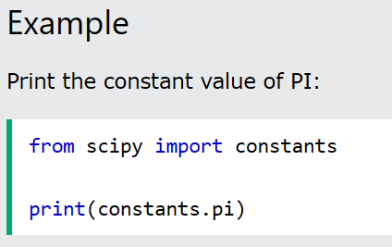
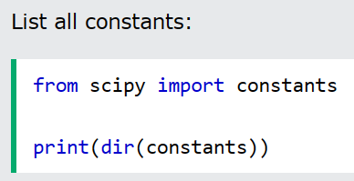
SciPy Constant
As SciPy is more focused on scientific implementations, it provides many built-in scientific constants.
There are various physical, mathematical constants and units that we can import the required constants and use them as per needed.

Slide 53
SciPy Constant
Sr. No. | Physical Constants | Description
1. | c | Speed of light in vaccum
2. | speed_of_light | Speed of light in vaccum
3. | G | Standard acceleration of gravity
4. | G | Newton Constant of gravitation
5. | E | Elementry charge
6. | R | Molar gas constant
7. | Alpha | Fine-structure constant
8. | N_A | Avagadro constant
9. | K | Boltzmann constant
10 | Sigma | Stefan-Boltzmann constant σ
11. | m_e | Electron mass
12. | m_p | Proton mass
13. | m_n | Neutron Mass
14. | H | Plank Constant
15. | Plank constant | Plank constant h

Slide 54
SciPy Constant/Units
Sr. No. | Units | Value
1. | Mass
 | Gram | One gram in Kilogram.
 | Grain | One grain in Kilogram.
 | Pound | One Pound in Kilogram.
 | Ounce | One Ounce in Kilogram.
 | automic_mass | Atomics mass constant in Kilogram.
2. | Time
 | Minute | One minute in seconds.
 | Hour | One hour in seconds.
 | Day | One day in seconds.
 | Year | One year in seconds.
3. | Length
 | Inch | One inch in meters.
 | Foot | One foot in meters.
 | Yard | One yard in meters.
 | Pt | One point in meters.
 | Micron | One Micron in meters.
4. | Pressure
 | Atm | The standard atmosphere in pascals.
 | Atmosphere | The standard atmosphere in pascals.
 | Bar | One bar in Pascals.
 | Torr | One torr(mmHg) in pascals.

Slide 55
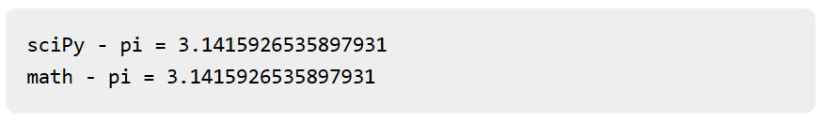
Example of Use of Scipy constants
Input
#lmport pi constant from both the packages
from scipy import constants
from math import pi
print("sciPy - pi = %.16f"%constants.pi)
print("math - pi = %.16f"%pi)
Output

Slide 56
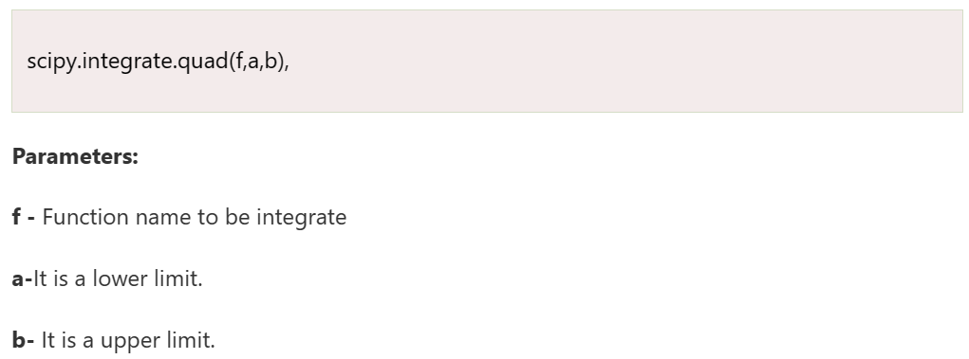
SciPy Integrate
Sometimes a function is very complicated to integrate or cannot be integrated analytically; then, it can be solved by the numerical integration method.
SciPy provides some routines for performing numerical integration. The scipy.integrate library contains most of these functions.
Numerical integrate is sometimes called quadrature. The Quad function is essential for SciPy's integration functions.

Slide 57
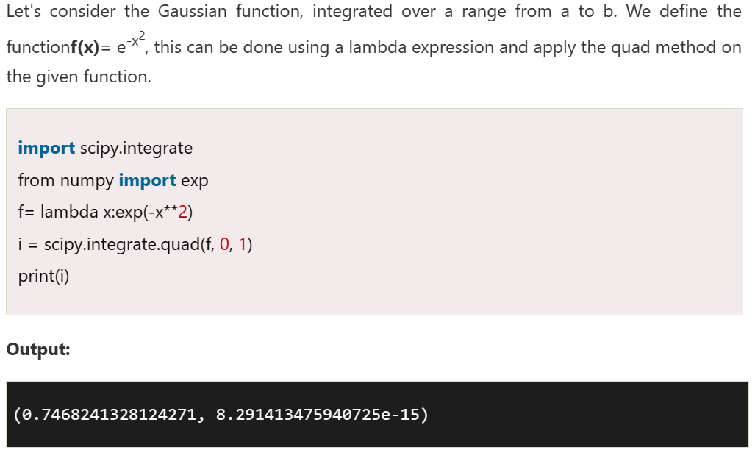
Example of integration
# Example of integration
from scipy import integrate
from numpy import exp
f = lambda x:exp(-x**2)
i = integrate.quad(f, 0, 1)
print(i)

Slide 58
SciPy Interpolation
Interpolation is defined as finding a value between two points on a line or a curve.
The first part of the word is "inter" as meaning "enter", which indicates us to look inside the data.
In the other words, "The estimation of intermediate value between the precise data points is called as interpolation".
Interpolation is very useful in statistics, science, and business or when there is a need to predict the value that exists within two existing data points.

Slide 59
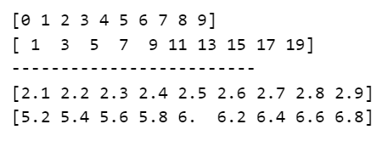
Example of Interpolation
import numpy as np
xs = np.arange(10)
ys = 2*xs + 1
print(xs)
print(ys)
print("-------------------------")
interp_func = interp1d(xs, ys)
newarr = interp_func(np.arange(2.1, 3, 0.1))
print(np.arange(2.1, 3, 0.1))
print(newarr)
Output

Slide 60
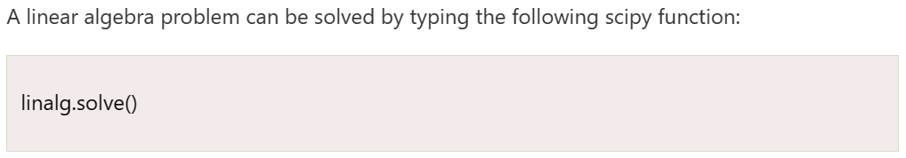
SciPy Linear Algebra
SciPy is built upon the ATLAS LAPACK and BLAS library, and it provides very fast linear algebra capabilities. Linear algebra routine accepts two-dimension array object and output is also given as a two-dimension array.

Slide 61
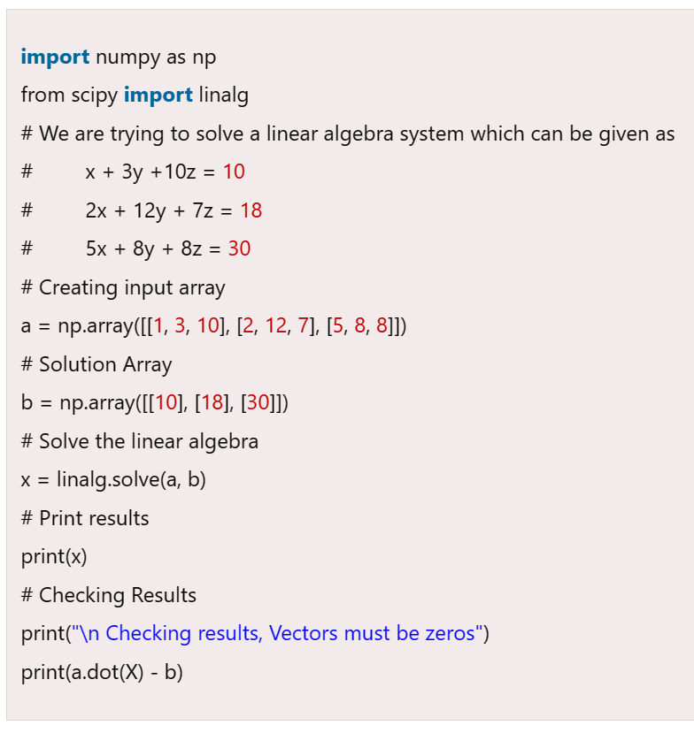
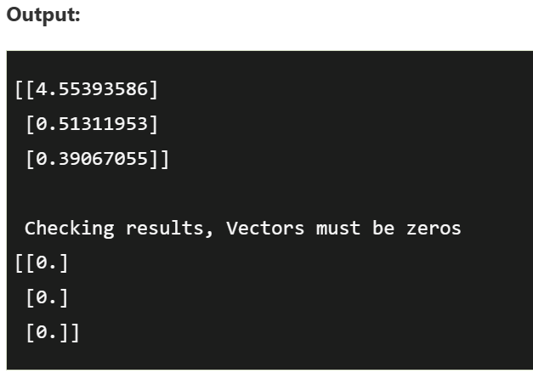
Example of Linear Equation
The linalg.solve is used to solve the linear equation a*x + b*y = Z, for the unknown x, y values.
x + 3y +10z = 10
2x + 12y + 7z = 18
5x + 8y + 8z = 30

Slide 62
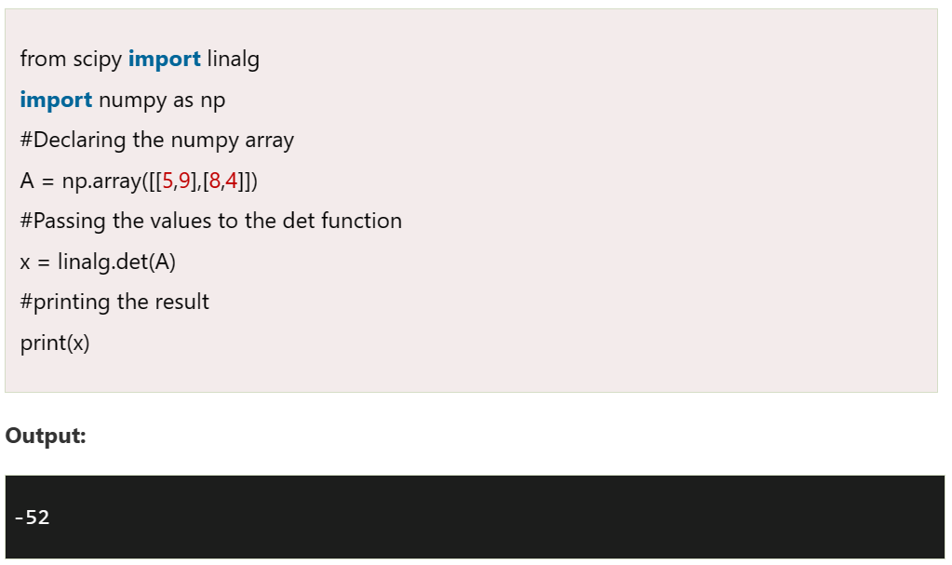
Finding the determinants
The determinant of the square matrix is found by using the linalg.det() function. The determinate A is often denoted as |A| in the linear algebra. It accepts a matrix and returns a scalar value.

Slide 63
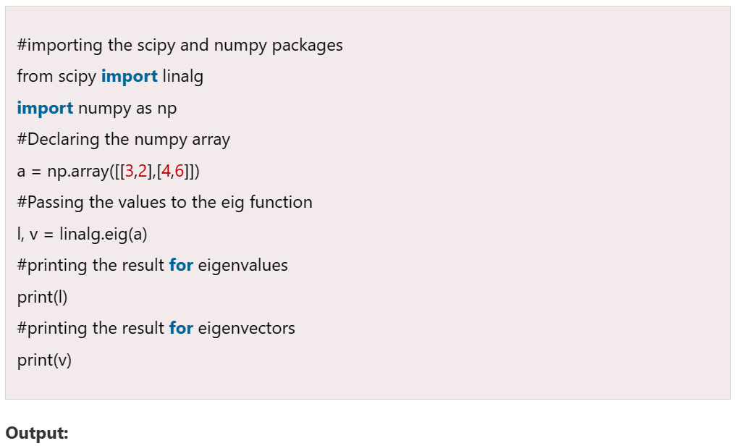
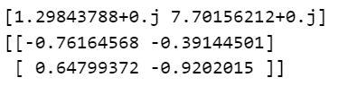
Eigenvalues and Eigenvectors
Finding eigenvalues and eigenvector problems are the most common problem in linear algebra. We can find the Eigenvalues and the corresponding Eigenvectors (v) of a square matrix (A) by linalg.eig() function.

Slide 64
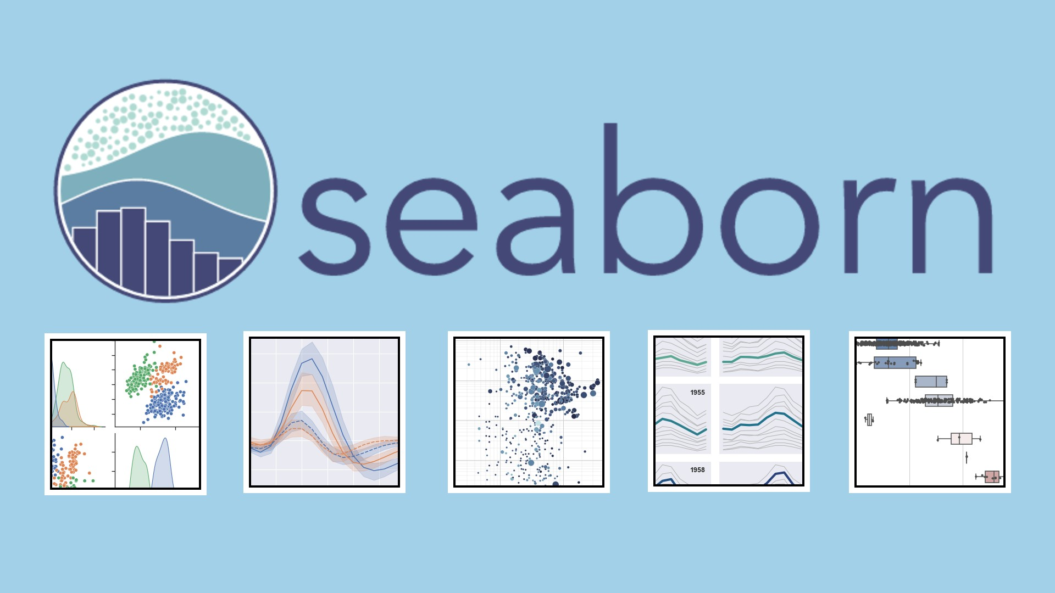
Introduction to Seaborn
Seaborn is a library mostly used for statistical plotting in Python. It is built on top of Matplotlib and provides beautiful default styles and color palettes to make statistical plots more attractive.
Seaborn is an open source, BSD-licensed Python library providing high level API for visualizing the data using Python programming language.
The best way to get insights is by visualizing the data. Data can be visualized by representing it as plots which is easy to understand, explore and grasp.

Slide 65
Important Features of Seaborn
Built in themes for styling matplotlib graphics
Visualizing univariate and bivariate data
Fitting in and visualizing linear regression models
Plotting statistical time series data
Seaborn works well with NumPy and Pandas data structures
It comes with built in themes for styling Matplotlib graphics

Slide 66
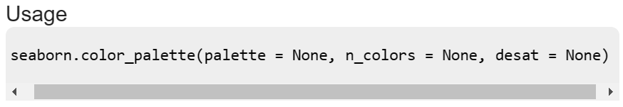
Seaborn - Color Palette
Color plays an important role than any other aspect in the visualizations. When used effectively, color adds more value to the plot. A palette means a flat surface on which a painter arranges and mixes paints.
Seaborn provides a function called color_palette(), which can be used to give colors to plots and adding more aesthetic value to it.
Sr.No. | Palatte & Description
1 | n_colors Number of colors in the palette. If None, the default will depend on how palette is specified. By default the value of n_colors is 6 colors.
2 | desat Proportion to desaturate each color.

Slide 67
Seaborn - Color Palette
It is hard to decide which palette should be used for a given data set without knowing the characteristics of data. Being aware of it, we will classify the different ways for using color_palette() types −
Qualitative
Sequential
Diverging

Slide 68
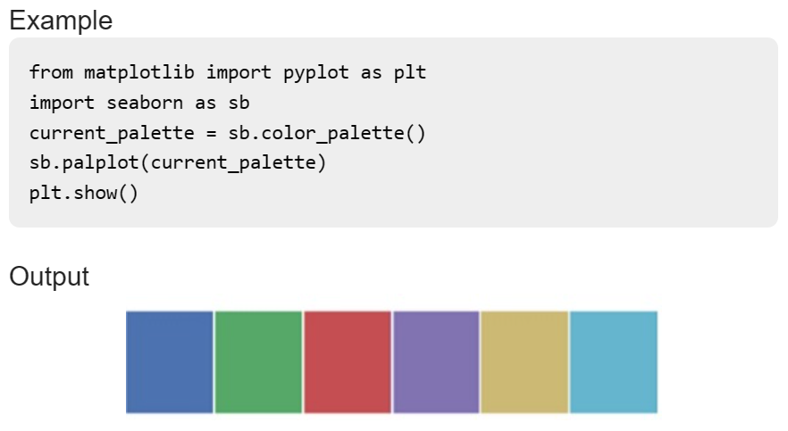
Qualitative Color Palettes
Qualitative or categorical palettes are best suitable to plot the categorical data.
We haven’t passed any parameters in color_palette(); by default, we are seeing 6 colors. You can see the desired number of colors by passing a value to the n_colors parameter. Here, the palplot() is used to plot the array of colors horizontally.

Slide 69
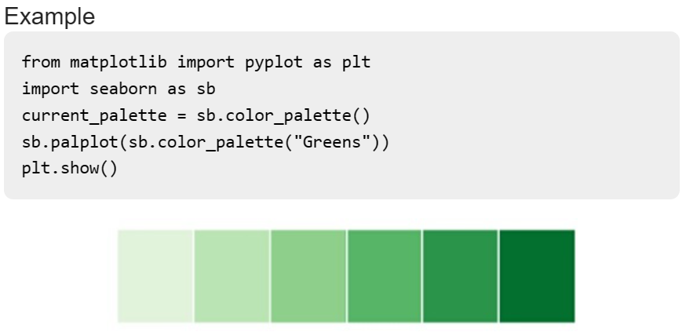
Sequential Color Palettes
Sequential plots are suitable to express the distribution of data ranging from relative lower values to higher values within a range.
Appending an additional character ‘s’ to the color passed to the color parameter will plot the Sequential plot.

Slide 70
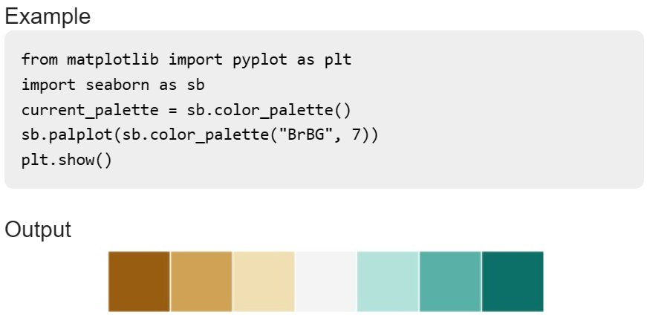
Diverging Color Palette
Diverging palettes use two different colors. Each color represents variation in the value ranging from a common point in either direction.
Assume plotting the data ranging from -1 to 1. The values from -1 to 0 takes one color and 0 to +1 takes another color.
By default, the values are centered from zero. You can control it with parameter center by passing a value.

Slide 71


Example of line plot using Seaborn

Slide 72


Seaborn - Histogram
Histograms represent the data distribution by forming bins along the range of the data and then drawing bars to show the number of observations that fall in each bin.

Slide 73

Introduction to plotly

Slide 74
Plotly-Python
The Plotly Python library is an interactive open-source library.
This can be a very helpful tool for data visualization and understanding the data simply and easily. plotly graph objects are a high-level interface to plotly which are easy to use.
It can plot various types of graphs and charts like scatter plots, line charts, bar charts, box plots, histograms, pie charts, etc.
Plotly has hover tool capabilities that allow us to detect any outliers or anomalies in a large number of data points.
It is visually attractive that can be accepted by a wide range of audiences.
It allows us for the endless customization of our graphs that makes our plot more meaningful and understandable for others.

Slide 75
Plot using plotly
Some of the visualizations you can expect to see include:
line plots,
scatter plots,
bar charts,
error bars,
box plots,
histograms,
heatmaps,
subplots,
and bubble charts.

Slide 76

Plotly histogram
A histogram is a representation of the distribution of numerical data with the data being grouped into bins. The count for each bin is then shown. In Plotly, the data can be aggregated using aggregation functions such as sum or average. In Plotly the data to be binned can also be categorical. Here’s an example:
# import all required libraries
import numpy as np
import plotly
import plotly.graph_objects as go
import plotly.offline as pyo
from plotly.offline import init_notebook_mode
init_notebook_mode(connected = True)
# save the state of random
np.random.seed(42)
# generating 250 random numbers
x = np.random.randn(250)
# plotting histogram for x
fig = go.Figure(data=[go.Histogram(x=x)])
fig.show()

Slide 77

Box plot using plotly
A box plot is the representation of a statistical summary. Minimum, First Quartile, Median, Third Quartile, Maximum.
# import all required libraries
import numpy as np
import plotly
import plotly.graph_objects as go
import plotly.offline as pyo
from plotly.offline import init_notebook_mode
init_notebook_mode(connected = True)
np.random.seed(42)
# generating 50 random numbers
y = np.random.randn(50)
# generating 50 random numbers
y1 = np.random.randn(50)
fig = go.Figure()
# updating the figure with y
fig.add_trace(go.Box(y=y))
# updating the figure with y1
fig.add_trace(go.Box(y=y1))
fig.show()

Slide 78

Pie chart
A pie chart represents the distribution of different variables among total. In the pie chart each slice shows its contribution to the total amount.
# import all required libraries
import numpy as np
import plotly
import plotly.graph_objects as go
import plotly.offline as pyo
from plotly.offline import init_notebook_mode
init_notebook_mode(connected = True)
# different individual parts in
# total chart
countries=['India', 'canada',
'Australia','Brazil',
'Mexico','Russia',
'Germany','Switzerland',
'Texas']
# values corresponding to each
# individual country present in
# countries
values = [4500, 2500, 1053, 500,
3200, 1500, 1253, 600, 3500]
# plotting pie chart
fig = go.Figure(data=[go.Pie(labels=countries,
values=values)])
fig.show()

Slide 79

Bar charts
Bar charts are used when we want to compare different groups of data and make inferences of which groups are highest and which groups are common and compare how one group is performing compared to others.
# import all required libraries
import numpy as np
import plotly
import plotly.graph_objects as go
import plotly.offline as pyo
from plotly.offline import init_notebook_mode
init_notebook_mode(connected = True)
# countries on x-axis
countries=['India', 'canada',
'Australia','Brazil',
'Mexico','Russia',
'Germany','Switzerland',
'Texas']
# plotting corresponding y for each
# country in x
fig = go.Figure([go.Bar(x=countries,
y=[80,70,60,50,
40,50,60,70,80])])
fig.show()

Slide 80

Scatter Plot
Scatter plot represent values for two different numeric variables. They are mainly used for the representation of the relationship between two variables.
# import all required libraries
import numpy as np
import plotly
import plotly.graph_objects as go
import plotly.offline as pyo
from plotly.offline import init_notebook_mode
init_notebook_mode(connected=True)
# generating 150 random integers
# from 1 to 50
x = np.random.randint(low=1, high=50, size=150)*0.1
# generating 150 random integers
# from 1 to 50
y = np.random.randint(low=1, high=50, size=150)*0.1
# plotting scatter plot
fig = go.Figure(data=go.Scatter(x=x, y=y, mode='markers'))
fig.show()

Slide 81
Introduction to Cufflinks

Slide 82
Cufflink
Cufflink connects plotly with pandas to create graphs and charts of dataframes directly.
Pandas is a very popular library in Python for data analysis. It also has its own plot function support. However, Pandas plots don't provide interactivity in visualization. Plotly's interactive and dynamic plots can be built using Pandas dataframe objects.
Plotly is built on top of d3.js and is specifically a charting library which can be used directly with Pandas dataframes using another library named Cufflinks.
First, import cufflinks along with other libraries such as Pandas and numpy which can configure it for offline use.
import cufflinks as cf cf.go_offline()

Slide 83

Bar plot using Cufflink
import pandas as pd
data = [['Ravi',21,67],['Kiran',24,61],['Anita',18,46],['Smita',20,78],['Sunil',17,90]]
df = pd.DataFrame(data,columns = ['name','age','marks'],dtype = float)
import cufflinks as cf
cf.go_offline()
df.iplot(kind = 'bar', x = 'name', y = 'marks')

Slide 84
Thank You

